Slide 1
“ Social license is a privilege,
not a right.”
- James Quincey, President and CEO, The Coca-Cola Company

Slide 2
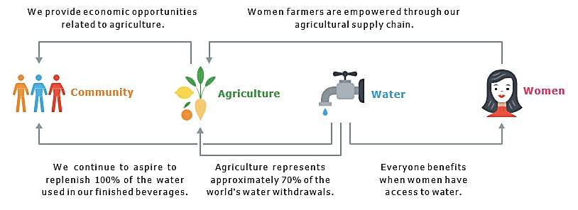
Our Sustainability Commitments 2020
GIVING BACK
$820 Million+
WATER
WOMEN
WELL-BEING

Slide 3
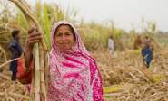
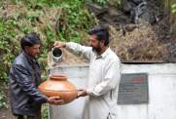
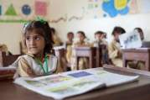
Building Consistently On Key Sustainability Pillars
WOMEN
WATER
WELL BEING
Economically empowered 7,000+ women through microfinancing in partnership with Kashf Foundation
Financial management workshops
83% of the respondents reported increase in savings
Vocational trainings to women for better employment opportunities
Improved health conditions and infant mortality rate
10 Projects for Water Stewardship in KPK, Punjab & Sindh
Replenished 800+ million liters of water in Ayubia National Park
Watershed, water filtration plants, bioengineering, plantations, energy conservation
Rotary Responsible Business Partner 2016 - Rotary Day at UN
2nd TCF School, Coca-Cola Campus near Lahore. 1st was in 2012 in Muzaffargarh
Coca-Cola Aquatic Center at LUMS – FINA approved swimming facility indoors
Coca-Cola Endowment Fund in LUMS for scholarships under National Outreach Programme
Separate latrines for female students to reduce student
drop out percentage

Slide 4
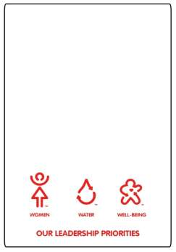
Building Consistently On Key Sustainability Pillars
Diverse CSR Portfolio worth $8m across Pakistan
The Most Well-Respected Company since 3 years in a row
SABRE AWARD 2016 FOR Best CSR Campaign with Kashf Foundation
4th Highest Corporate Reputation Score across 200+ countries

Slide 5
Our CSR Partners

Slide 6
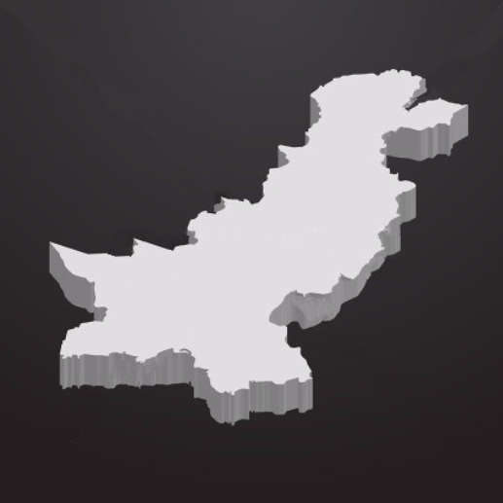
WATER STEWARDSHIP
221 billion liters
of water replenished through community
& watershed projects
across the globe
Siksa Village, GB. Integrated water resource management for food security, safe drinking water and sanitation 4,000 beneficiaries
30 Million liters recharged
Ayubia National Park
Integrated Sub-watershed Management & Environmental Awareness launched in 2008
Groundwater recharge of 782 million liters
135,000 beneficiaries & female participation in CBOs
Peri-Urban /Rural Areas around Lahore . Society for Empowerment and Environmental Protection
7 Sewage Water Treatment Systems & WASH practices
Kohistan Thatta District. Water For Women - Rain Water Harvesting, Rehabilitation of Dug Wells, Check Dams, Hand Pumps
$180,000 granted by The Coca-Cola Foundation
600 households in some 35+ villages
7 catchment sites in Sindh
Solar-Powered Water Filtration Plants
30% decrease in water borne diseases
90% reduction in polio cases
Ownership of plants transferred to communities

Slide 7
For more information log on: www.coca-colajourney.com.pk

